Slide 1

D
ODGE GAME
Player Name : Kim/Lee Hyunju
Team Code : #013

Slide 2
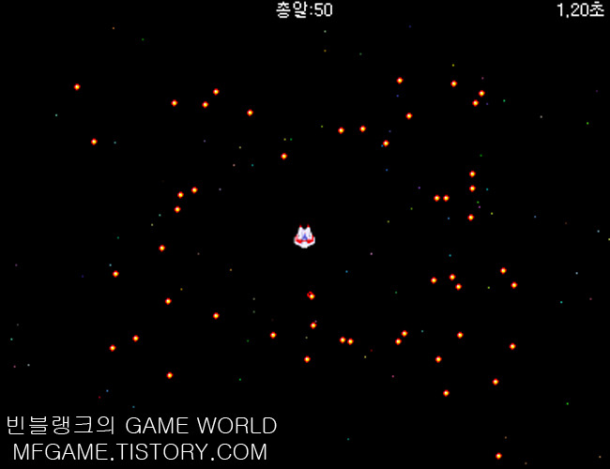
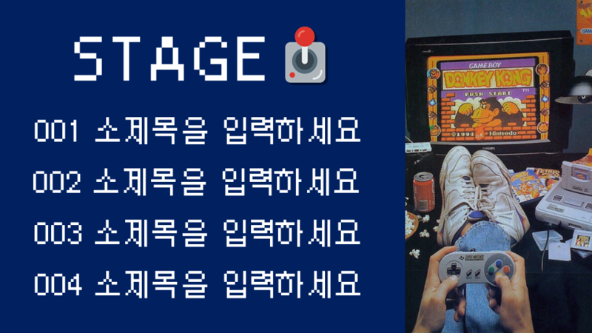
Game Introduction
Game Algorithm
Problem Solving
Game Demonstration

Slide 3
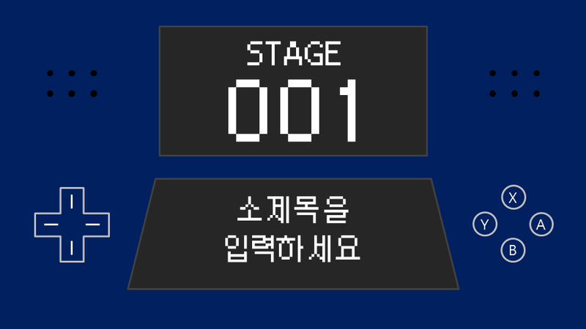
Game
Introduction

Slide 4


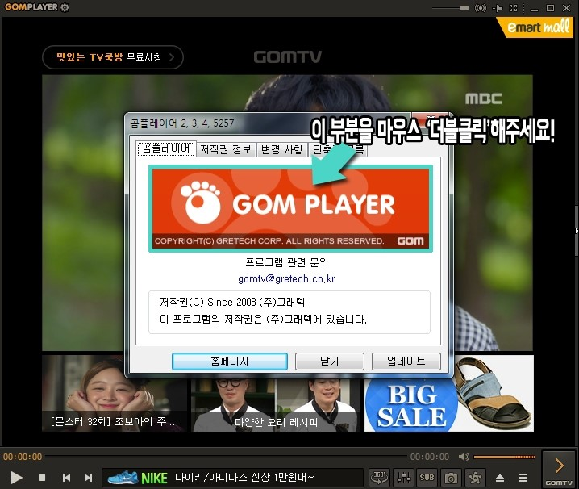
001
Game Introduction
What is the Dodge game?
Press
F1 key

Slide 5
001
Game Introduction
* Game start *
* Game over *

Slide 6
001
Game Introduction

Slide 7
001
Game Introduction

Slide 8
2
Game
Algorithm

Slide 9
002
Game Algorithm
Press the spacebar to start a game.
Move the main character using ↑, ↓, →, ← key.
If the character hits with aggressive balls, the game is over.
If the game is over, screen prints out the time record.

Slide 10
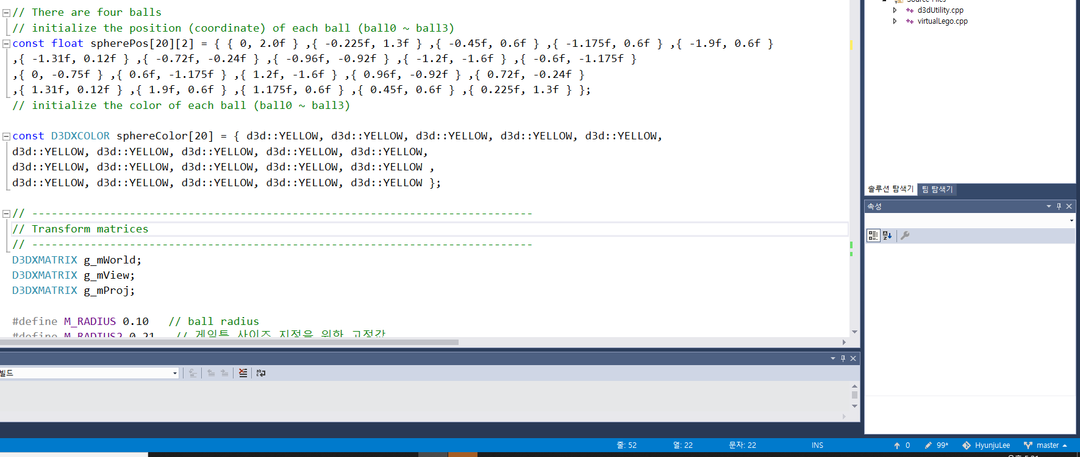
002
Game Algorithm
0. Initialization

Slide 11
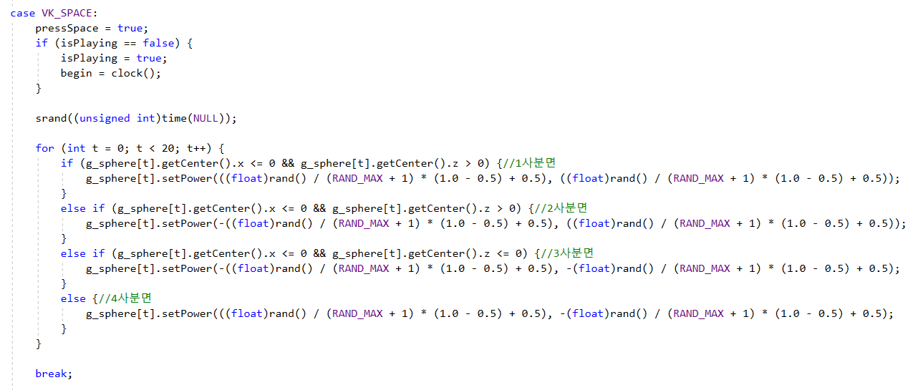
002
Game Algorithm
1. Press the spacebar to start a game.

Slide 12
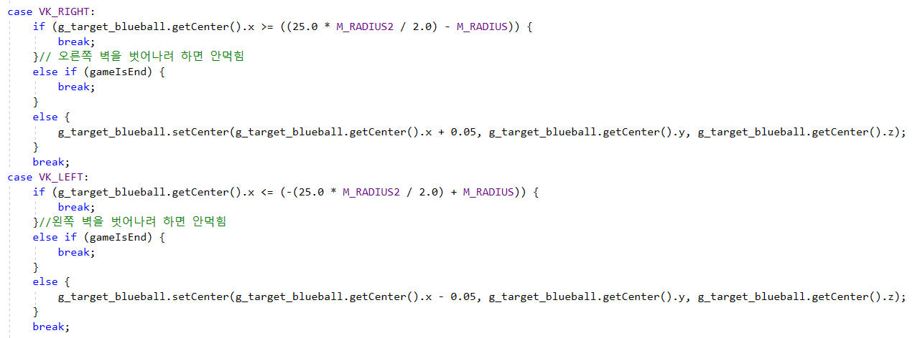
002
Game Algorithm
2. Move the main character using ↑, ↓, →, ← key.

Slide 13
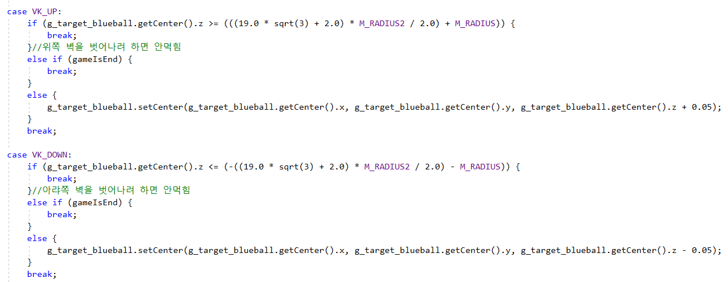
002
Game Algorithm
2. Move the main character using ↑, ↓, →, ← key.

Slide 14
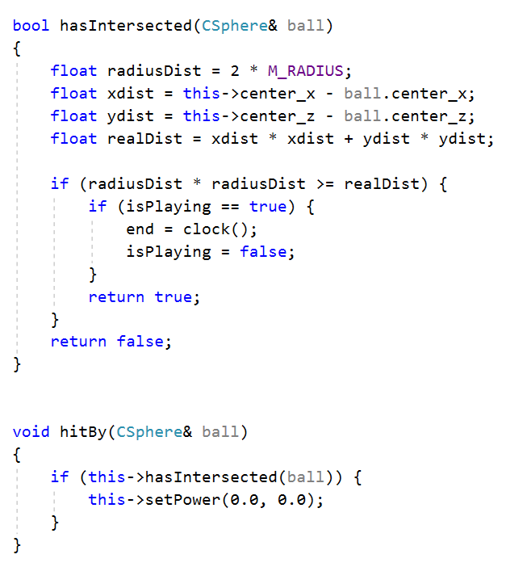
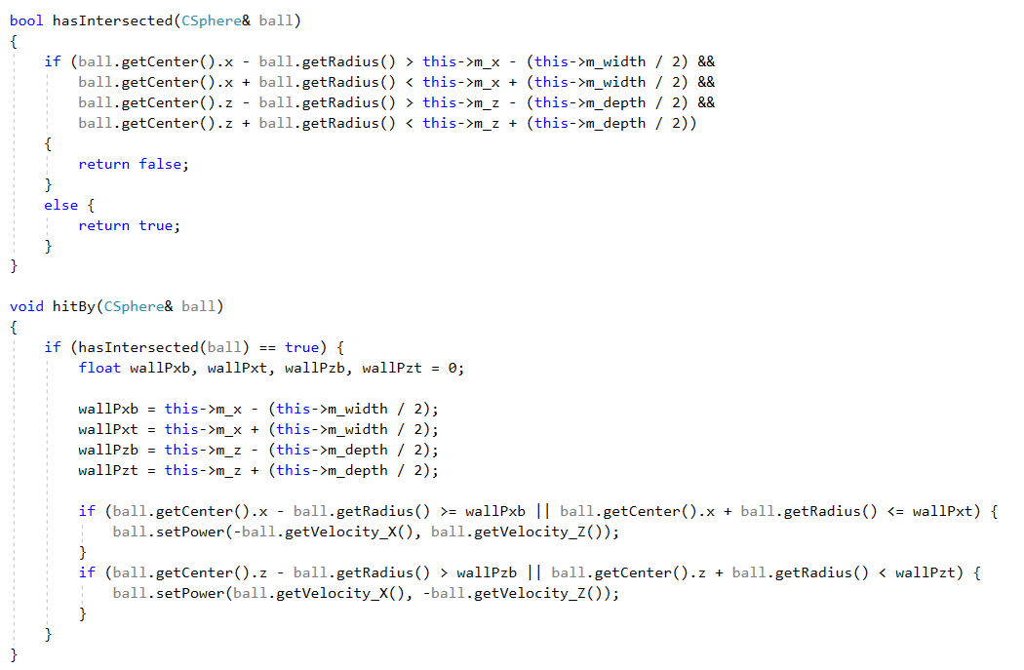
002
Game Algorithm
3. If the character hits with aggressive balls, the game is over.

Slide 15
002
Game Algorithm
4. If the game is over, screen prints out the time record.

Slide 16
002
Game Algorithm

Slide 17
3
Problem
Solving

Slide 18
003
Problem Solving

Slide 19
4
Game
Demonstration

Slide 20
004
Game Demonstration

Slide 21


